Slide 1


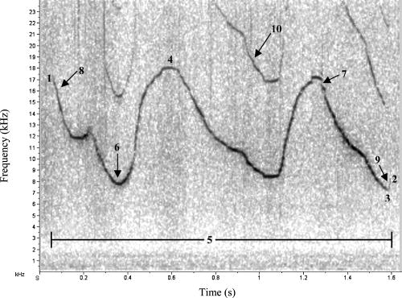
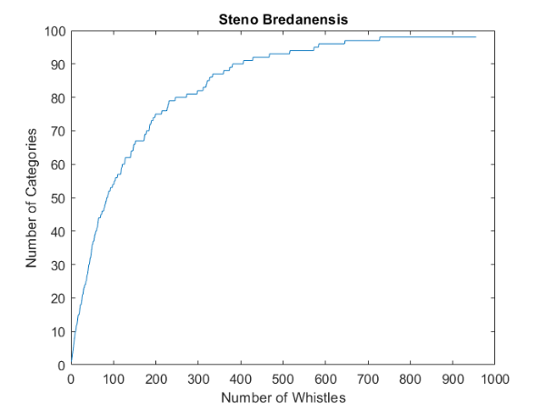
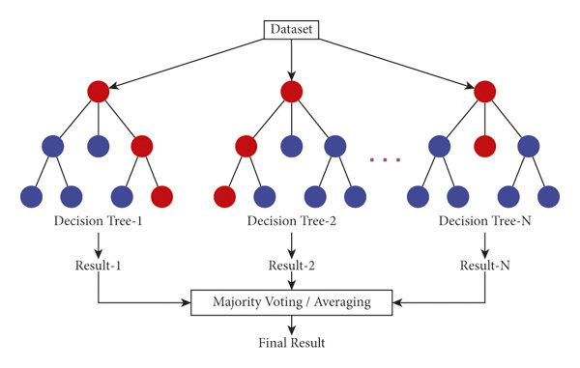
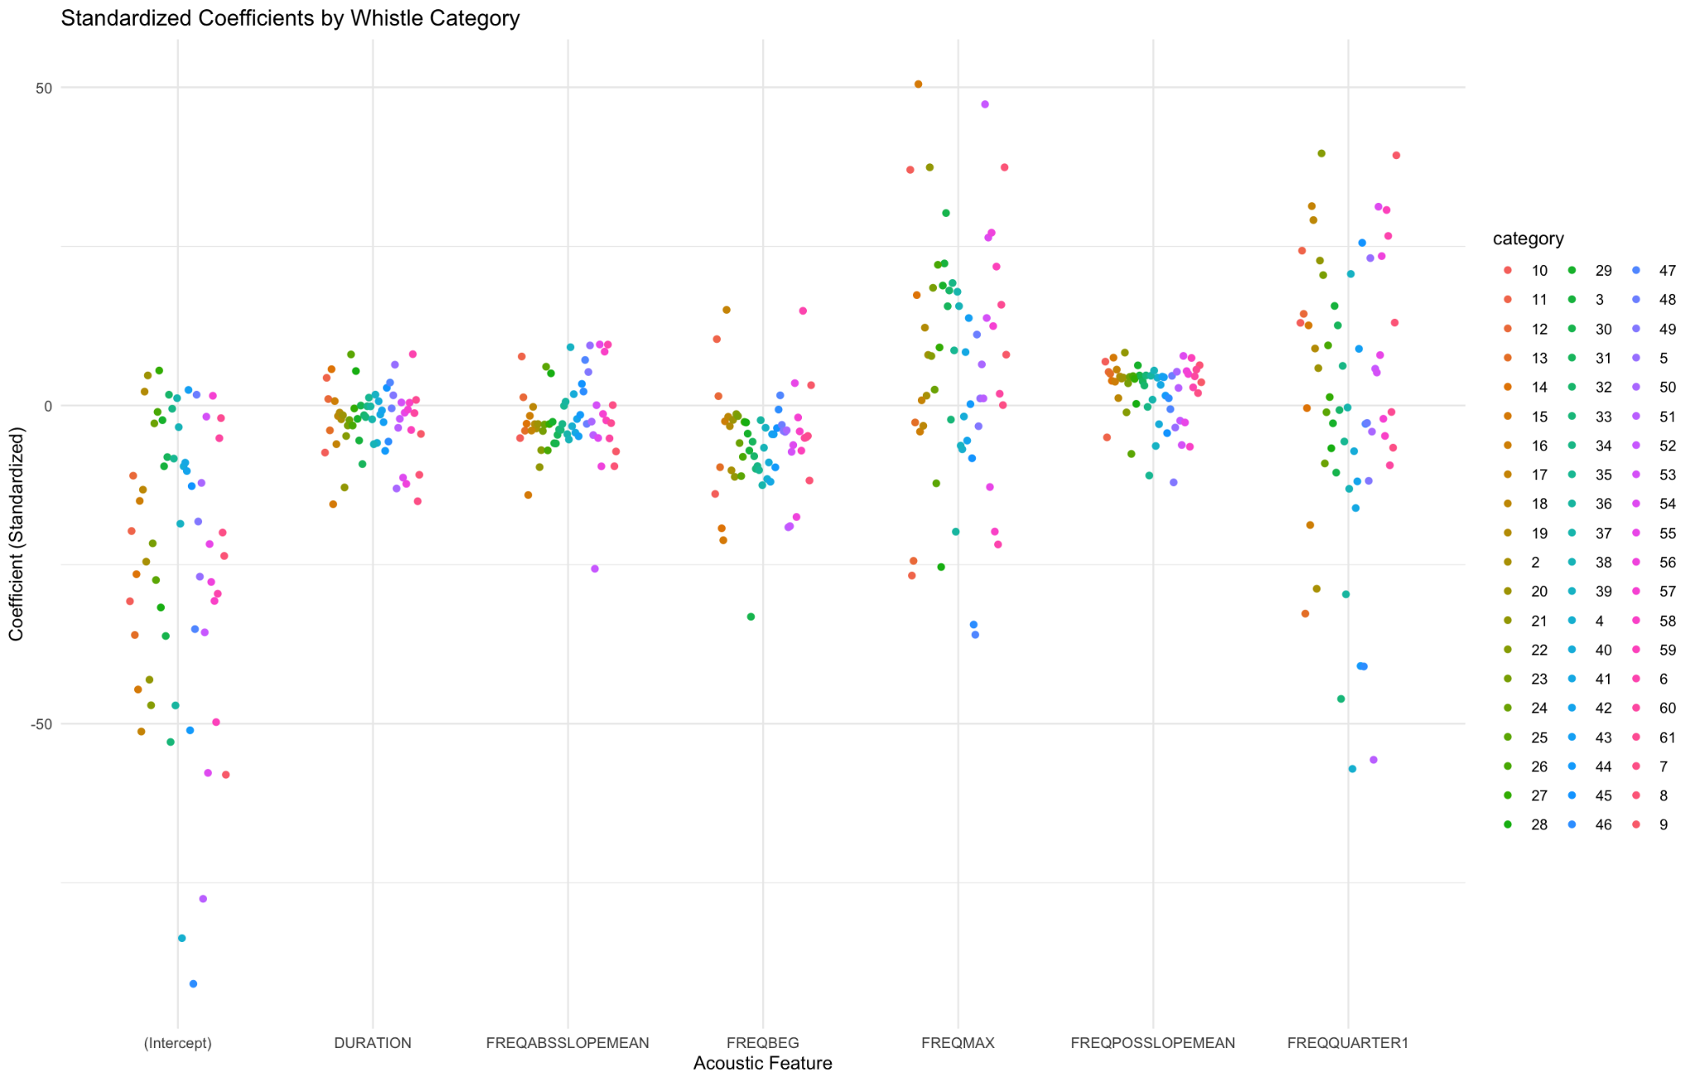
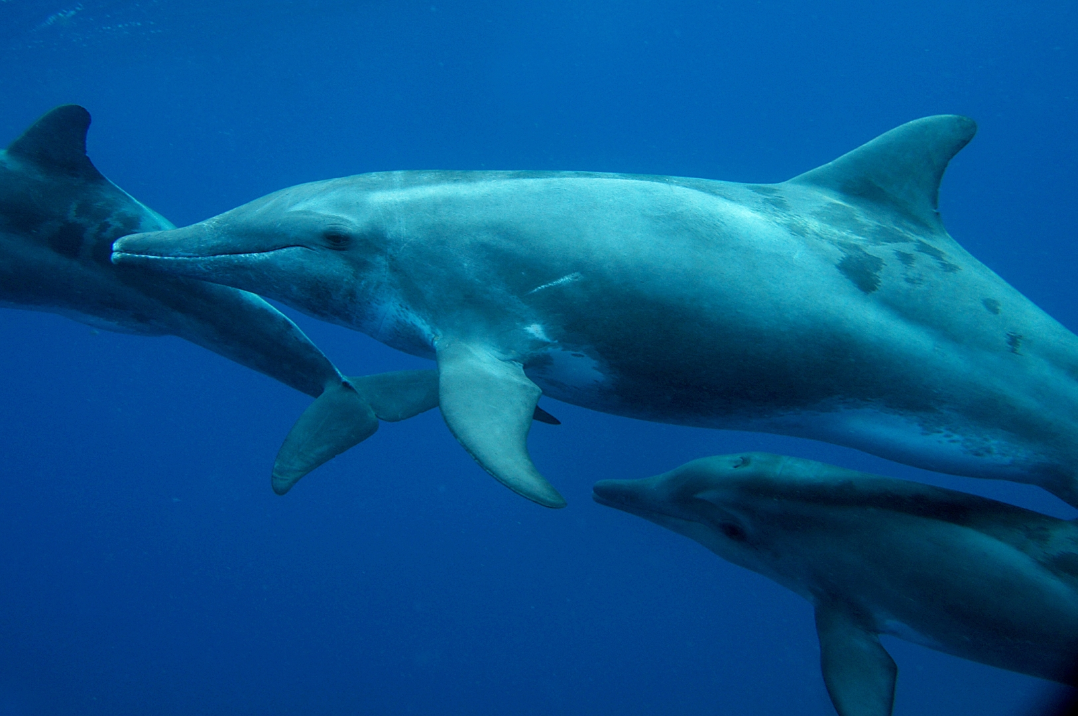
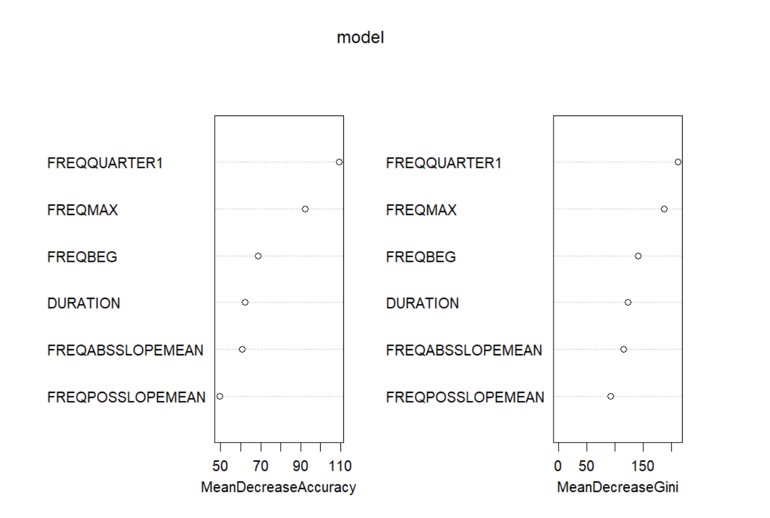
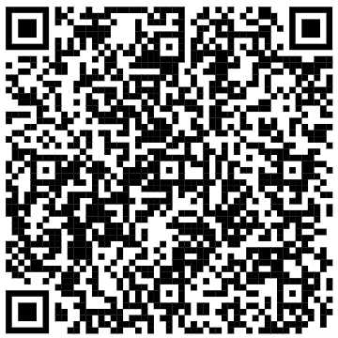
Statistical Modelling Techniques for Predicting Whistle Categories of the Rough-Toothed Dolphin
Jenny Galloway, Ashby Shiril, Yves Yuen
Danielle Harris, Julie N. Oswald, Hannah Worthington
1. Introduction
Analysing the types of whistles dolphins produce helps develop our understanding of these fascinating creatures.
We aim to research dolphin communication, specifically similarities and differences in whistles across different populations of the rough-toothed dolphin (Steno bredanensis).
We aim to describe the whistle repertoire of this species by using statistical models to identify key features of the whistles that make them different from each other.
2. Data Gathering
3. Models and Their Uses
Two model types were considered to investigate how the variables differed between whistle categories:
Data is received from teams tracing whistles in a spectrogram (an image of sound, Fig. 1) and analysed using software called ROCCA and ARTwarp to classify whistles into categories, outputting multiple measurements per whistle.
A Multinomial Generalized Linear Model (GLM) is used for categorical response variables with more than two outcomes (e.g.,whistle category).
It extends logistic regression to handle multiple categories instead of just binary classification.
In this case, categories are the whistle categories from ARTwarp.
Pros:
It shows the relative importance of each variable.
It can help understand the relationship between different key features of whistles (e.g. maximum frequency and duration) in the data.
Cons:
Model fit is not possible with too many variables.
The model may require a relatively large sample size.
Fig 1: A spectrogram of a whistle
Data to be used in the model consists of six key measurements (called variables for the models):
duration, maximum frequency,
first quartile and starting value of the frequency,
the mean of the absolute and positive slope of the frequency change over time
Figure 2: A discovery curve of whistle categories was used to determine the ideal number of whistles for modelling.
The slope of the discovery curve flattens at 800 whistles, meaning additional data offers minimal benefit.
Random Forest Modelling is a machine learning method for classification and prediction. In this case we used it for classification of dolphin whistles into whistle categories.
Works by building multiple decision trees, each using different combinations of whistle measurements (e.g. max frequency, duration).
A decision tree is a flowchart-like model where you follow each branch until you get to the prediction in the end.
The final whistle category prediction is the majority vote across all trees.
Pros:
Reduces overfitting by averaging decision trees.
Provides feature importance, aiding in interpretability.
Cons:
Model is inconsistent when there are many variables
The model may require a relatively large sample size.
4. Results and Comparisons of the Models
Fig 3: An image of random forest decision trees process
Figure 5: Results of Multinomial GLM modelling are:
The graph shows the relative contribution of each of the variables with values above 0 contributing more to the model
Figure 6: Results of Random Forest modelling are:
After averaging the results of 100 random model runs, the accuracy of this model was 67.68%
The graph shows us how important each feature is in contributing for classification.
Fig 4: Image of a Rough-toothed dolphin. (Photo credit: Guadeloupe FWI ©Laurent BOUVERET / OMMAG)
5. Final Statements and Conclusion
From Multinomial GLM, we found that the maximum and quartile 1 of the frequency of whistles are the most distinguishing factors.
This helps us understand what are the main acoustic features involved in the categorization and differentiation of whistles.
We decided on Multinomial GLM over Random Forest as the most suitable model to use.
Multinomial GLM:
Allows for hypothesis testing and confidence intervals.
Is easier to interpret.
Is faster to run, making it more time efficient especially for larger datasets.
6. References & Additional Content
The list of references can be seen by scanning the QR code on the right: For further information email us at viprojects@st-andrews.ac.uk
Notes:
https://commons.wikimedia.org/wiki/File:Steno_bredanensis_LB_1.jpg

